Slide 1
Ill effects of smoking

Slide 2
Introduction
Smoking is the inhalation of the smoke of burning tabacco encased in cigarettes, pipes, and cigars.
A smoking habit is a physical addiction to tabacco products.
It became a psychological addiction, too, and one with serious health consequences.

Slide 3
Cigarette contains
Acetone
Aluminum
Ammonia
Arsenic
Benzene
Butane
Cadmium
Carbon monoxide
Corban dioxide
chloroform
Cyanide
DDT/Dieldrin
Ethanol
Formaldehyde
Hydrogen cyanide
Lead
Methanol
Nicotine
Tar
Vinyl Chloride

Slide 4
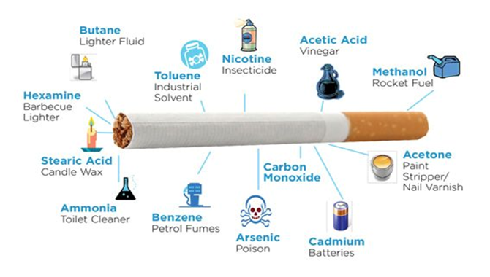
A cigarette contains

Slide 5
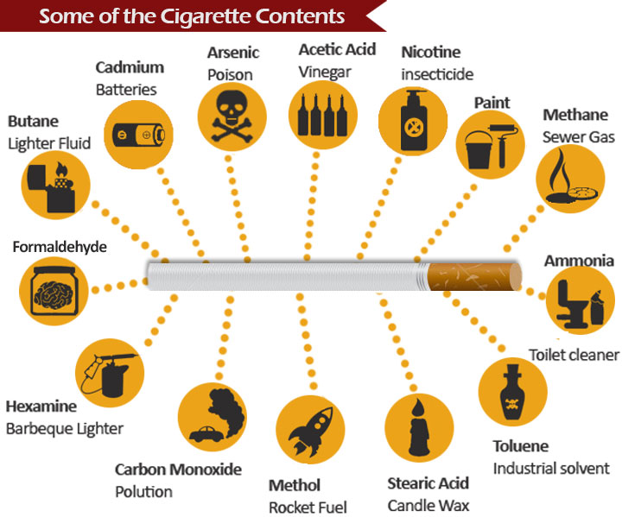

Slide 6

Ill effects of smoking
Early death
Poor health
Addiction
Cancer
Heart disease
Gum disease
Cavities
Air pollution

Slide 7
Effects of smoking
Nervousness
Wrinkles and premature aging
Tension
Gastric, duodenal, and peptic ulcers
Lung cancer
Cancer of the lip, tongue, pharynx, bladder
Emphysema
High blood pressure
Heart disease
Atherosclerosis & arteriosclerosis
Inflammation of the sinus passages
Tabacco angina
Impaired hearing
Mental depression
Decreased sexual activity
Stained teeth, finders, and hair
Increased frequency of colds
Asthma
Neuralgia
Gastrointestinal difficulties, constipation, diarrhea etc.
Headaches
Nausea
Convulsions
Insomnia
Heart murmur
Buerger’s disease
Arthritis
Smokers' snack

Slide 8

Harmful effects of smoking

Slide 9
Conclusion
It is easy to become a smoker, but it is difficult to quit.
If you are not started till now, a vow not to light your first cigarette at any time in your life.
If you are smoker, never to touch the next cigarette, and avoid the company of your friends who still smokers.
Never again light a cigarette for your entire lifetime, because the difference between a chain smoker and occasional smoker is too thin in cross.

Slide 10
Thank you

